Slide 1
Path Analysis & Sequence Modelling
Regularization of RNN through
Bayesian Neural Networks
Vish Hawa
CAI: Center for Analytical Insights
April 18 , 2019
Notes:
Test results
Math - loss functions
Vector interpolation – next best action
Optimal path from a positon
Bayes info and prior

Slide 2
PROBLEM SETUP
Marketing leads are exposed numerous channels, it is difficult to isolate how much credit should be attributed towards each channel. This can have big impact on how much budget /efforts should be put into any particular channel
Usage of First Touch or Last Touch Attribution - can potentially overweigh on first or last touch channels and be sub-optimal in credit assignments
Are there sequences that are better at driving leads than others? Build model and Conduct Path Analysis and Produce weights to channel contribution for each path
RNNs have shown great promises on sequence-modelling (can they solve memorizing issues especially when data size is limited)

Slide 3
SEQUENCE COMBINATIONS
Marketing and Operation Channels
Touch-Points
Touch-Points
Touch-Points
ADV
WEB
WEB
ADV
EMAL
SR
MAIL
WEB
PHONE
ADV
WEB
SR
MAIL
PHONE
PHONE
ADV
WEB
ADV
Touch Point Facts
Touches range from 1 – 1000+ , median 15 touches
Possible space: 7¹⁵ ~ 5T Paths! (ordered sequence)
Even sequence length of 10 ~ 300M paths!
Very sparse evidence

Slide 4
RNN AS SEQUENCE MODELER
Stacking : 2 –layers
Seq. Length: 5
Dense: 2-layer with linear out
Optimizer: RMSprop
Loss: MAE
IN: 5-dim embedding of channels
240 Units of GRU Cells
Dropout = 0.3
ADV
40%
Increase of
~ 2 folds !!
ADV - EM
93%
ADV – EM - PHONE
20%
Drops to 20% ~ up again 4x
ADV – EM – PHONE - EM
80%

Slide 5
RNN AS SEQUENCE MODELER
Points - of Discontinuities
“Modeling of Symptoms ”
Touch-Points
Extremities
Prominent when data size is small compared to possibilities
More skewed the strength of evidence - higher the discontinuity
Higher dropout rate helps – may not solve it
True features (z) are latent unobservable
can we do better ?
Notes:
L2 normalization – check

Slide 6
BAYSIAN NEURAL NETWORK AND LOSS FUNCTION
Bayesian Modelling as Variational Encoders
We use Variational Inference (Bayes-by-back prop) to learn posterior probabilities in latent space $z$
Since true posterior p is unknown ~ approximated by variational distribution $q\left(z | x\right)$ stochastic “encoder” and likelihood $p\left(k | z\right)$ as stochastic “classifier”
The loss objective to be minimized:
the regularized divergence between p and q and the classification loss
$β$ : disentangled parameter
Minimize Loss : $Σβ(log{q\left(z | x\right)}−\log{p\left(z\right)) −\log{p\left(k | z\right)}}$
Choice of prior $p\left(z\right) =N(0,1)$ : Regularizer enforces not to memorize data points
The marginal probability of new data point:
$$p(k|x)=\int_{0}^{n}{p\left(k | x,z\right)p\left(z\right)dz}$$
Var($p(k|x)$) : uncertainty estimation
z : latent variable
x : new data point
p(k) : predictive probability
of the class
n : sampled points

Slide 7
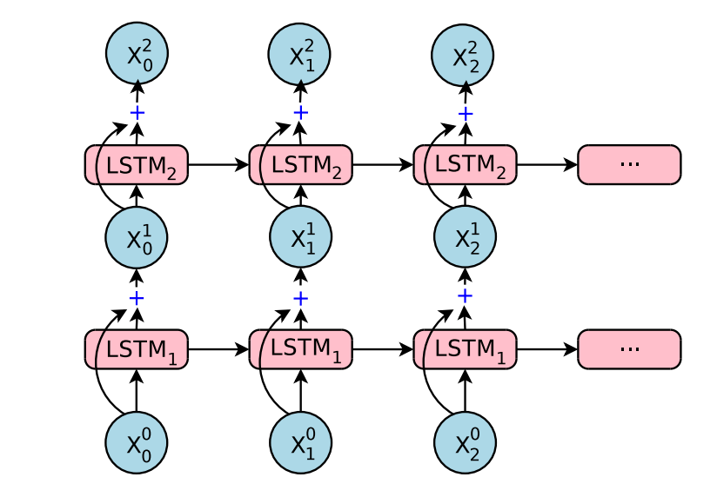
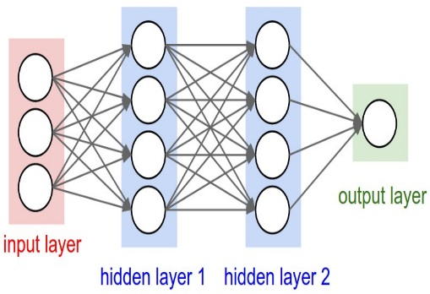
ARCHITECTURE: DISENTAGLED VARIATIONAL ENCODER
Latent
Space
(z)
sampled
$z$₁
Dense layers
$$p\left(x\right)$$
Input Layer
Reparametrized
$$p\left(k | z\right)∗p(z)$$
$z$₂
STACKED RNN
CLASSIFIER
Information Flow
Embedding layer
Minimize Loss : $Σβ(log{q\left(z | x\right)}−\log{p\left(z\right)) −\log{p\left(k | z\right)}}$
Disentangled:
Increasing $β$-factor forces to use only a few latent variables
The latent variables will then represent causal features of the data
We want $zi$ to be un-correlated (mean-field inference assumption)
$β$-factor too small can overfit the data ~ “posterior collapse”
$β$-factor too big can hurt performance ~ keep accuracy on check

Slide 8
REGULARIZED MODEL
ADV – EM
40%
Maintains consistent range over probabilities
ADV – EM – PHONE
25%
ADV – EM – PHONE - EM
30%

Slide 9
LATENT SPACE VECTORS
WO
PH
A
PH-EM-PH
B
EM
ADV
Inferences drawn:
‘Next Best Action’ – most influential channel touch to provide
Optimal sequence - sequence of touches for maximum effect towards desired objective (* may require optimization procedure)

Slide 10
TAKE AWAYS
Small data sets RNNs will memorize sequences – worse when possible space is large
Weigh the sequence by strength or evidence seen
Model in latent-space do not model symptoms Regularize through prior distributions
One approach : Disentangled Variational encoder
“Top-Down” Approach : high latent space vectors (z) and scale downwards
Trade-off with $β$
Bonus: Latent Space opens up avenues for vector-arithmetic ~ such as ‘Next Best Action’
Develop efficient rules on how to treat a lead with channel-impressions

Slide 11
REFERENCES
Bayesian Neural Nets
https://arxiv.org/abs/1505.05424 [arxiv.org] -
InfoVAE: Information Maximizing Variational Autoencoders
https://arxiv.org/pdf/1706.02262.pdf
Understanding disentangling in β-VAE
https://arxiv.org/abs/1804.03599
Auto-Encoding Variational Bayes
https://arxiv.org/abs/1312.6114
http://papers.nips.cc/paper/7141-what-uncertainties-do-we-need-in-bayesian-deep-learning-for-computer-vision.pdf
ELBO Surgery
http://approximateinference.org/accepted/HoffmanJohnson2016.pdf

Slide 12
THANK YOU

Slide 13
APPENDIX

Slide 14
COMBINED: RNN + BAYES-NET
Query the network for conditional probability queries CPQ
BN = for each do P(Client=1 | path/sequence)
Compute Label as dot product: Client*BN
RNN Loss function: -Σ_{i} Client*BN log(yHat )
Truncated sequence for better generalization k{5,10}
ID | CLIENT | N | SEQUENCE (k=5) | BN+ | MAE(Client*B+) | Score (RNN)
1000007488 | 1 | 4 | EMAL EMAL Web Web Web | 0.41 | 0.41 | 0.66
1000038000 | 1 | 15 | EMAL ADV Web Web Web | 0.28 | 0.28 | 0.43
1000041267 | 1 | 11 | ADV EMAL Web Web Web | 0.11 | 0.11 | 0.41
Ordered path score: Regularized by BN and computed by RNN based on evidence observed

Slide 15
FEATURE SELECTION
Differential Evolution Optimization
STACKED RNN
Dense layer
Embedding layer
DOT PRODUCT
Bayesian Score –> Dot Product –> Ordered Score –> Optimal Path Selection
PAS
ADV
EM
DM
Web
WO
PH
BDG
Flow
BAYSIEAN NETWORK
Gaussian

Slide 16
STACKED RNN/LSTM
RNNs will memorize sequences
Worse when data size is small compared with possible space
Similar performance in ‘out of sample’ cases
POID | CLIENT | COUNTS | SEQUENCE (k=5) | Score
1000007488 | 0 | 4 | EMAL EMAL Web Web Web | 0.09
1000038000 | 0 | 15 | EMAL ADV Web Web Web | 0.43
1000041267 | 1 | 11 | ADV EMAL Web Web Web | 0.00
Approach: External Regularization can perform better than tune-up

Slide 17
Stacking : 2 –layers
Seq. Length: 5
Dense: 2-layer with linear out
Optimizer: RMSprop
Loss: MAE
IN: 5-dim embedding of channels
64 Units of LSTM Cells
Dropout = 0.3
Bayes Rule :
Posterior α Likelihood * Prior

Slide 18
Illustration: SEQUENCE OF TOUCHPOINTS
Touch-Points
Touch-Points
Touch-Points
ADV
WEB
WEB
ADV
EMAL
BDG
A
MAIL
WEB
PHONE
ADV
WEB OFFER
BDG
B
MAIL
PHONE
PHONE
ADV
WEB
ADV
C
Falling Interest
Rates
Surging Investor
Sentiments
Low Market
Volatility
PATH FUN FACTS
Over 200K path combinations observed
Touches range from 1-50+ , mostly 15 touches or less
Possible space: 12¹⁵ Paths! (the universe)
Clients can be sensitive to Channels types and macro-economic climate and their own changing needs

Slide 19
COMBINED ARCHITECTURE
BAYSIEAN NETWORK
Client Y/N
ADV
EM
DM
Web
WO
PH
BDG
STACKED RNN
Dense layer
GAUSSIAN NET
DOT PRODUCT
Information Flow
Embedding layer
Bayesian Score –> Dot Product –> Ordered Score
{Optimal Path Selection}

Slide 20
BAYESIAN NETWORK INFERENCE
Inference on Bayesian networks consists of conditional probability (CPQ) given some evidence (Marginal)
Maximum a posteriori (MAP) queries {finding configuration q* of variables/nodes that has highest posterior probability}
Path: ADV/DM-PH-PAS
Rescue: Regularize through PGMs
Make use of conditional probabilities ~ BNs
Solution: for each ‘path’ calculate odds for positive and negative cases
..but destroys the ‘order/sequence information’
How do we apply ?
ADV
DM
Web
PH
Client Y/N
CPQ: P(Client =Y |Web=0)

Slide 21
SECTIONS

